Slide 1
Public Health Nutrition
NU5079/DT5079/PT5052
Afshan Aghili

Slide 2


Aims of the session:
Overview of historical perspectives of Public Health
Definitions of Public health
Role of Public Health Professionals
Role of Public Health Nutrition (PHN)
Discuss Public Health Campaigns

Slide 3
Learning Outomes
By the end of this session, you should be able to:
Have knowledge of the commencement of PH and its historical progression.
Recognise the role of PH.
Understand the different modes of practice in PH.

Slide 4
By the end of this module, you should be able to:
Critically evaluate public health and nutrition interventions
Differentiate and integrate clinical, community and population approaches
Apply systems thinking to nutrition‑related health challenges
Analyse the role of policy, power and inequality in shaping diet and health
Justify intervention choices using evidence and public health principles

Slide 5

Many definitions
“The science and art of promoting and protecting health and wellbeing, preventing ill health and prolonging life through the organised efforts of society" Faculty of PH
‘‘Public health is about helping people to stay healthy and protecting them from threats to their health. The government wants everyone to be able to make healthier choices, regardless of their circumstances, and to minimize the risk and impact of illness’’ PHE

Slide 6
Core Public Health Areas
Environmental Health
Social and Behavioural Science
Health policy
Biostatistics
Epidemiology

Slide 7
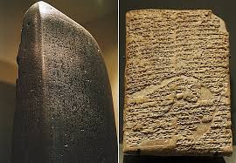
Code of Hammurabi 1700
Earliest legal codes
Addressed regulation of medical practice and professional accountability!
Compares medical treatment to other professions
States that a medical doctor not doing their job properly is as punishable as other professionals like blacksmiths not doing their job or a boat builder that builds an inadequate boat which puts lives in danger.

Slide 8
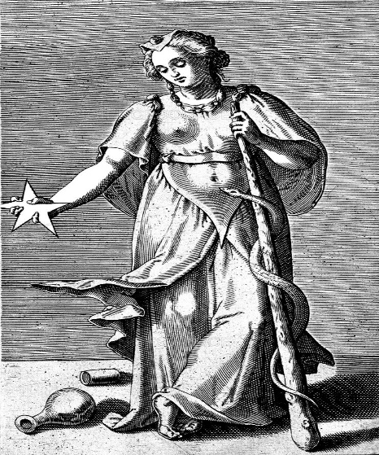
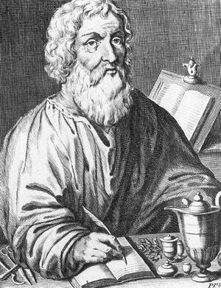
Ancient Greece 400 BC
Goddess Hygeia (goddess of health):
Cleanliness and hygiene resulted in good health. Dirt would result in ill health
Hippocrates- father of modern medicine:
First person to attribute disease to natural causes and not to superstition or a god…
Ethical code of conduct & how medical practitioners had to hold themselves to a set of standards
Anyone graduating in medicine has to take the Hippocratic Oath

Slide 9
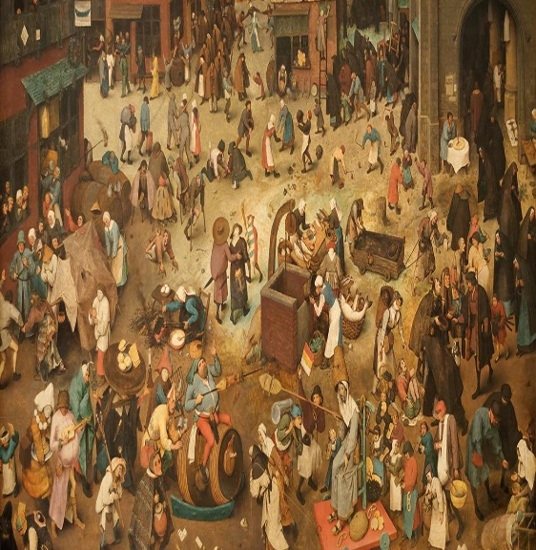
Medieval period (5th-15th AD)
City building in Europe
Overcrowding (housing)
Rubbish piling, not collected
No sewage systems
Unsanitary
POOR NUTRITION
Sickness increased
Sickness as punishment for sin (still believed in some parts)
Infectious diseases such as leprosy, typhus, smallpox..) spread & killed large numbers
War

Slide 10
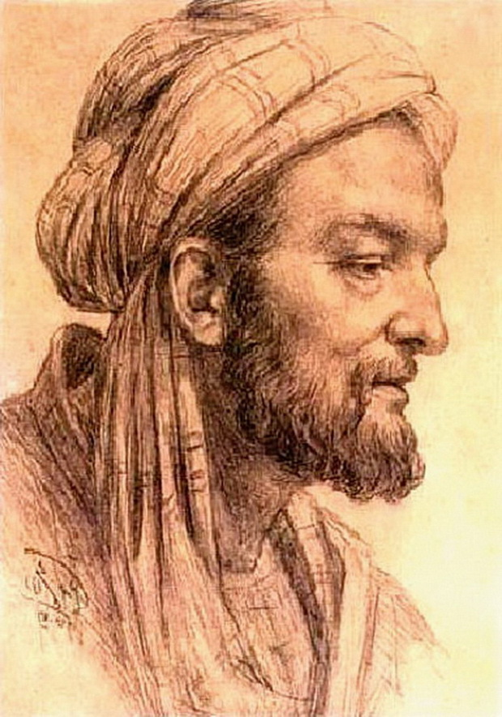
Golden Age 8-13th AD (Arab World)
Avicenna a book in medicine
Averroes first person to talk about Parkinson’s disease
Maimonides brilliant polymath who was first to mention healthy lifestyle & longevity
Early forms of medical case review and professional accountability
Started by a Syrian - medical notes & outcomes to see if punishable or not

Slide 11
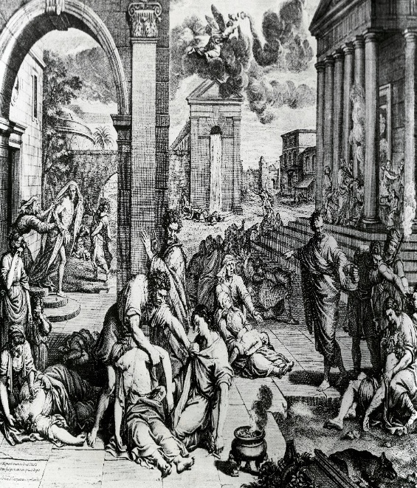
Epidemics in Europe 14th-16thC
The Plague epidemic 14-17th C:
Start of epidemiology
An estimated 75–200 million deaths across Europe, Asia and North Africa
Quarantine- a public health policy that can be traced to the Black Death of the 14th century
Towns and cities developed systems of quarantine to isolate travelers and merchandise that came from places known to be infected

Slide 12
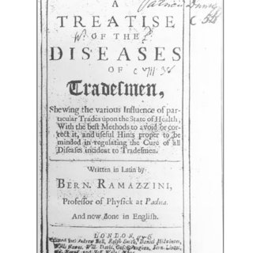
16-18th Century
Spread of epidemics such as smallpox, measles, typhus, malaria across Europe
Physiology, microscopy & clinical medicine started to develop
1700 first treatise on occupational diseases
Industrial revolution: improved agriculture and nutrition

Slide 13
19th C Miasma & Germ Theories
Miasma theory: miasma cause disease
Germ theory: specific microorganism cause disease
Koch (1890) bacteria led to disease (1890)
Louis Pasteur (1862) rejected the theory of spontaneous generation of life
John Snow (1854): Broad Street Pump- story of epidemiology: Cholera outbreak. Identified all cases on a map. Initially blamed the water pump. First example of modern epidemiology
Edward Jenner: (1796) Smallpox vaccine
Louis Pasteur vaccine against rabies(1885)

Slide 14
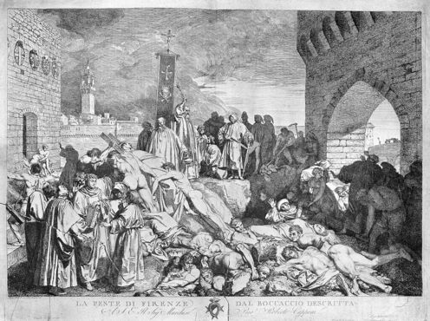
Historical Perspective of Public Health in Britain
              The Sanitary Idea - in the 2nd quarter of the C19th
              Commencement of a central public health administration which directed local authorities to provide drains, sewers, street cleaning…
Globalisation of public health
Global threats to public health in the 19th C led to International Health Diplomacy
Many international public health agreements were created between mid-19th-mid 20th C

Slide 15
Public Health: Key Historical Milestones
1700 BCE – Code of Hammurabi: early regulation of medical practice
400 BCE – Hippocrates: disease attributed to natural causes
8th–13th C – Islamic Golden Age: medical scholarship, early health ethics
14th C – Black Death: emergence of quarantine and epidemiological thinking
18th C – Jenner: vaccination and disease prevention
19th C – Sanitary reform, germ theory (Pasteur, Koch), public health infrastructure
20th C – Epidemiology, vaccination programmes, WHO, non‑communicable disease focus
21st C – Systems approaches, health inequalities, commercial determinants of health

Slide 16
Major International Public Health Advancements:
1851: Conference on Cholera
1914: WW1, 1939: WW2 Holocaust
1940s: Introduction of community water fluoridation
1946: WHO set up
1948: Human Rights Declaration
1950: First reports linking tobacco & lung cancer
1952: Polio Vaccine
1953: DNA Structure Watson & Cricks
1954: Framingham study
1978: First IVF baby
1980s: Aids case recognised in US
1991: Folic Acid & Neural Tube defects

Slide 17
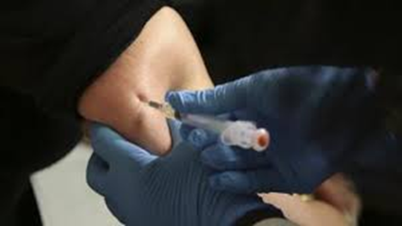
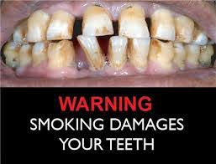
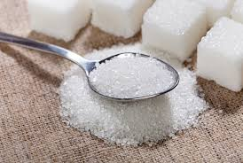
Progress in Public Health
Control of infectious disease
Immunization
Eradication of many diseases
Shift from communicable to non-communicable diseases
Fluoridation of water
Family planning
Safer foods
Decline in CVD & stroke
Decline in smoking
Motor vehicle safety
Workplace safety

Slide 18
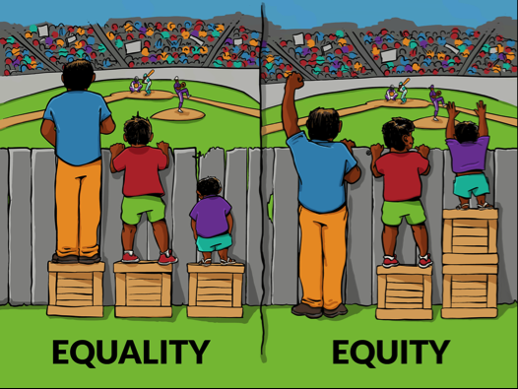
What Does Public Health Do?
Improve health largely by promoting healthcare equity, quality & accessibility

Slide 19
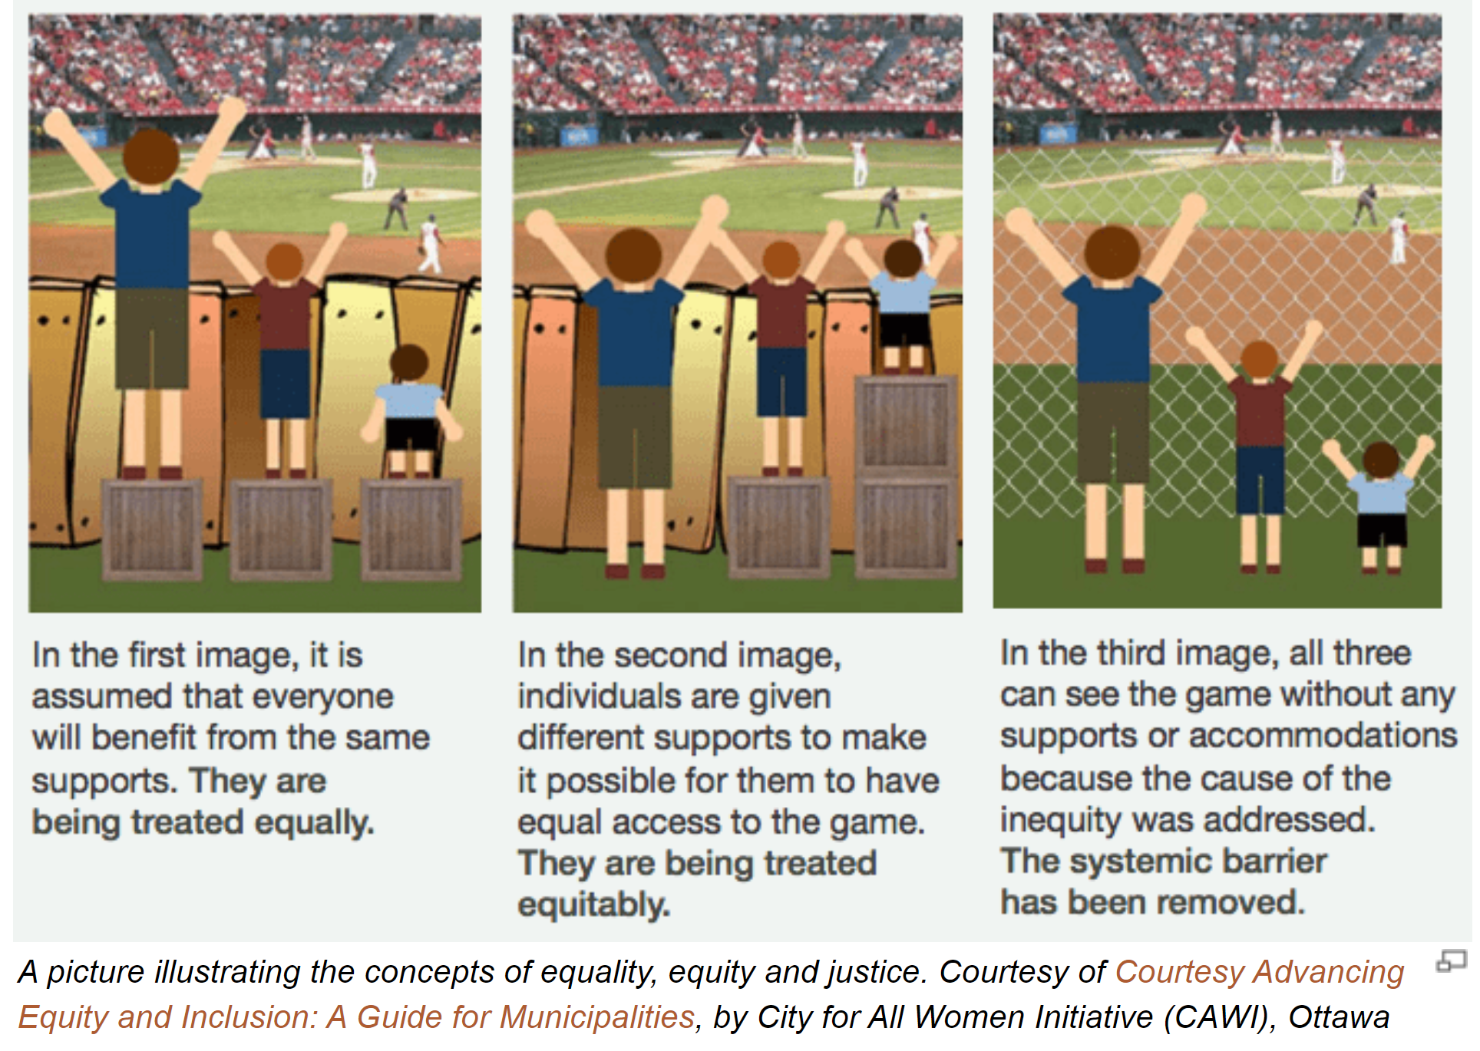

Slide 20
What is Public Health Nutrition (PHN)?
Public Health Nutrition is concerned with:
the promotion, protection and maintenance of nutrition‑related health and wellbeing at population level,
through policy, systems, environmental and behavioural interventions,
informed by epidemiological evidence and social determinants of health.
Notes:
Relatively new and evolving area of practice
Focused on solving nutrition problems & developing interventions for populations

Slide 21
Key characteristics of PHN practice:
Operates at population and sub‑population level, rather than individual care
Addresses structural, social, economic and environmental determinants of diet and health
Integrates nutrition science, public health, behavioural science and policy
Focuses on prevention, equity and sustainability
Requires intersectoral action (health, education, food systems, local government)
PHN draws on principles of health promotion:
“Enabling people and communities to increase control over the determinants of health and improve health outcomes.”

Slide 22
Prevention in Public Health Nutrition
In public health nutrition, prevention refers to interventions implemented before disease onset, targeting upstream determinants of diet and health rather than downstream treatment.
Defining features:
Implemented across whole populations or defined population groups
Focused on risk reduction, resilience and health‑enabling environments
Uses multiple, coordinated strategies (policy, education, regulation, environmental change)
Prioritises equity and proportionate universalism
Evaluated over medium to long timeframes

Slide 23
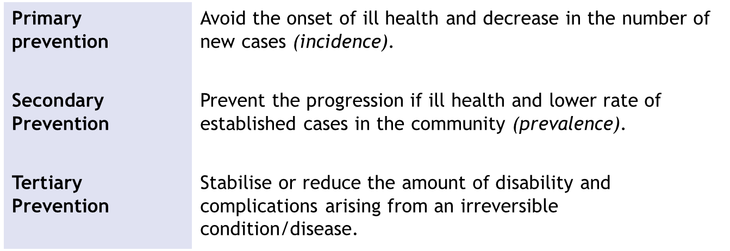
Levels of Prevention
  The term ‘prevention’ is reserved for interventions that occur before the diagnosis of a condition/ disease is made
  Levels of prevention – conventional classification

Slide 24
Levels of Prevention in Public Health Nutrition
Key distinction:
Public Health Nutrition primarily operates at primary and secondary prevention, while clinical dietetics is predominantly tertiary.
Level | Focus | Nutrition Examples
Primary | Prevent disease before it occurs | Food reformulation (salt/sugar), fiscal policies, mandatory fortification, school food standards
Secondary | Early detection & risk identification | NHS Health Checks, gestational diabetes screening, childhood obesity surveillance
Tertiary | Reduce complications of established disease | Dietetic management of diabetes, CVD rehabilitation programmes

Slide 25
Different Modes of Nutrition Practice
  Clinical dietetics utilises scientific principles and methods in the treatment of illness, by optimising the nutritional status of individuals in an institutional environment
  Community dietetics utilises scientific principles and methods in the treatment of illness, by optimising the nutritional status of individuals in a community setting
  Community and Public Health Nutrition utilises scientific principles and practice in the promotion and prevention of nutrition related illness, by optimising the nutritional status of communities, sub-populations & whole populations

Slide 26
Modes of Nutrition & Dietetic Practice
Clinical Dietetics
Individual‑level therapeutic nutrition care
Predominantly tertiary prevention
Biomedical and clinical outcomes
Typically delivered in healthcare settings
Community Dietetics
Individuals and small groups in community settings
Mix of secondary and tertiary prevention
Focus on access, behaviour change and service delivery
Community & Public Health Nutrition
Whole populations and sub‑populations
Primarily primary prevention
Focus on policy, environments, systems and inequalities
Delivered through multi‑sectoral partnerships

Slide 27
Comparing Modes of Nutrition Practice
Dimension | Clinical Dietetics | Community Dietetics | Public Health Nutrition
Unit of action | Individual | Individual / group | Population
Primary prevention role | Limited | Moderate | Central
Dominant paradigm | Illness | Risk management | Health & equity
Key drivers | Referral & diagnosis | Community need | Policy, evidence, population need
Outcome timeframe | Short–medium | Medium | Medium–long
Workforce | Dietitians | Dietitians | Multi‑disciplinary

Slide 28
Public Health Nutrition Practitioners
Registered Dietitians & Nutritionists are qualified to translate the science of nutrition into safe, impartial, practical & up to date food-based guidance for groups, & to develop policies that promote good health
PH nutritionists: https://www.associationfornutrition.org/careers-nutrition/becoming-nutritionist/career-profiles
PH dietitians: https://www.bda.uk.com/specialist-groups-and-branches/public-health-specialist-group/what-do-public-health-dietitians-do.html

Slide 29
Areas of interest to PHN
Social, behavioral, nutrition-related factors that affect health
Design, implementation & evaluation of programs to improve the nutritional status of the population or subgroups in the population
Nutrition and food policies which affect health
Interventions to improve the nutritional status of those at risk

Slide 30
Major Areas of Public Health Practice
Surveillance & assessment of the population's health & wellbeing
Assessing the evidence of effectiveness of health & healthcare interventions, programs and services
Strategic leadership & collaborative working for health
Health Improvement, Health Protection
Policy and strategy development and implementation (2010 Faculty of Public Health,2010)

Slide 31
Policy & Strategy development & implementation
Policy: Statement of what the government is trying to achieve and why. Specific principles adopted by organisations, teams etc often based on evidence but strongly influenced by politics, public opinion, and the media
Strategy: Steps that need to be taken for achieving the changes needed over long term. Needs to be supported by evidence. The strategy sets out actions for various partners in public health system to support and develop policies, it is a formally planned set of actions to address a particular issue.

Slide 32
Policy
In England, 63% of adults and 1 in 3 children leaving primary school are living with overweight or obesity
Higher risk of type 2 diabetes, heart disease & certain cancers.
Excess weight can make it difficult to find and keep work, affect self-esteem and mental health…
Health problems associated with being overweight or obese cost the NHS an estimated £6.1 billion every year.
By 2030, government wants to see:
  a downward trend in the level of excess weight in adults
  Halve the number of children living with excess weight
  https://www.gov.uk/government/publications/tackling-obesity-government-strategy/tackling-obesity-empowering-adults-and-children-to-live-healthier-lives

Slide 33
Strategy
Helping people to make healthier choices
Programs to encourage and help people to:
Eat and drink more healthily
Be more active
Giving people advice on a healthy diet and physical activity through Change4Life programme
Improving labeling on food and drink to help people make healthy choices A consistent front of pack labelling system that makes it clear what is in food and drink
Encouraging businesses on the high street to include calorie information on their menus so that people can make healthy choices
Give people guidance on how much physical activity they should be doing

Slide 34
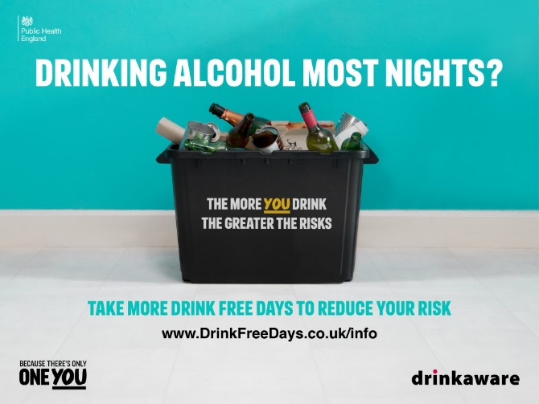

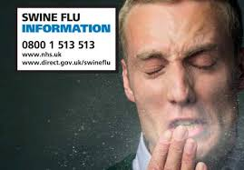
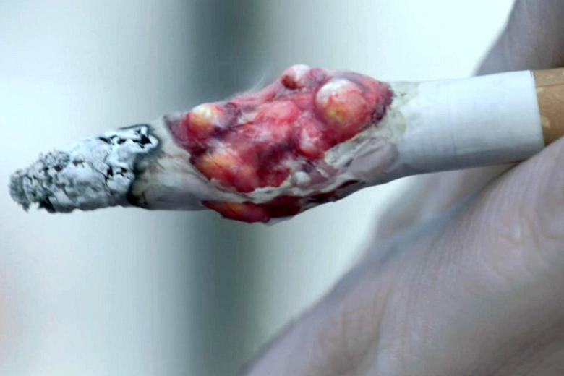
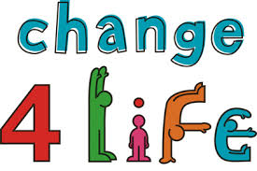
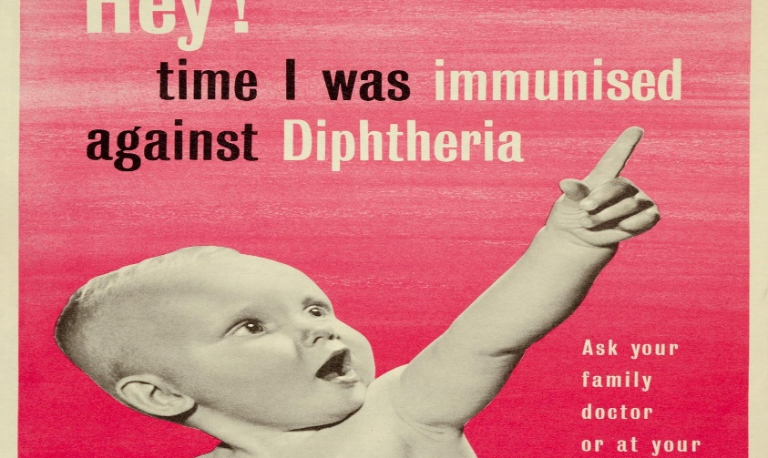
https://www.gov.uk/government/news/campaign-launched-to-help-public-get-healthy-this-summer

Slide 35

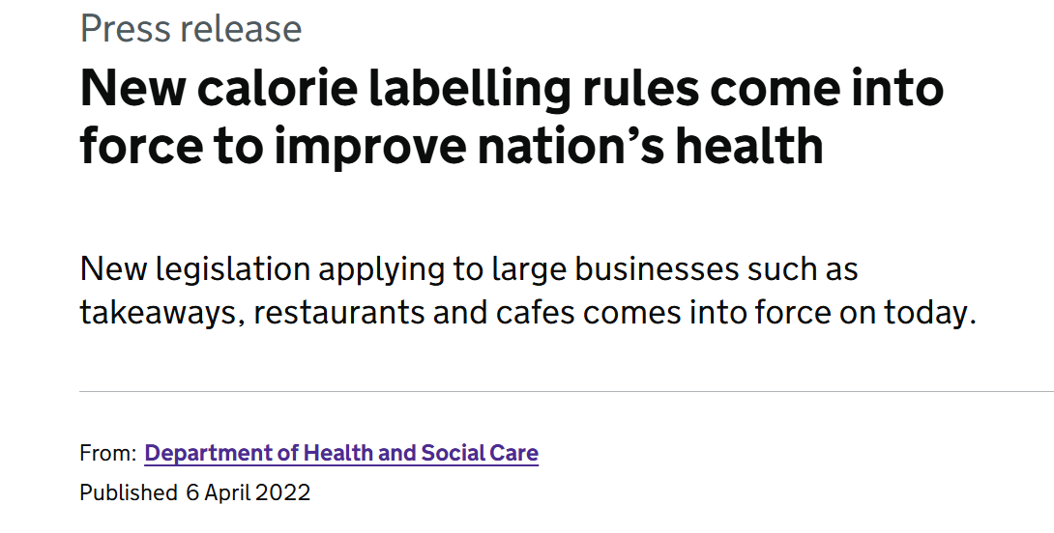
Calorie Labelling
Voluntary pledges, 2011, 17% in OHFS in England provided kcal information & adherence to good practice guidance low (Robinson et al, 2019)
Mandatory action, no significant decrease in kcals bought or consumed in OHFS England (Polden et al, 2024)

Slide 36
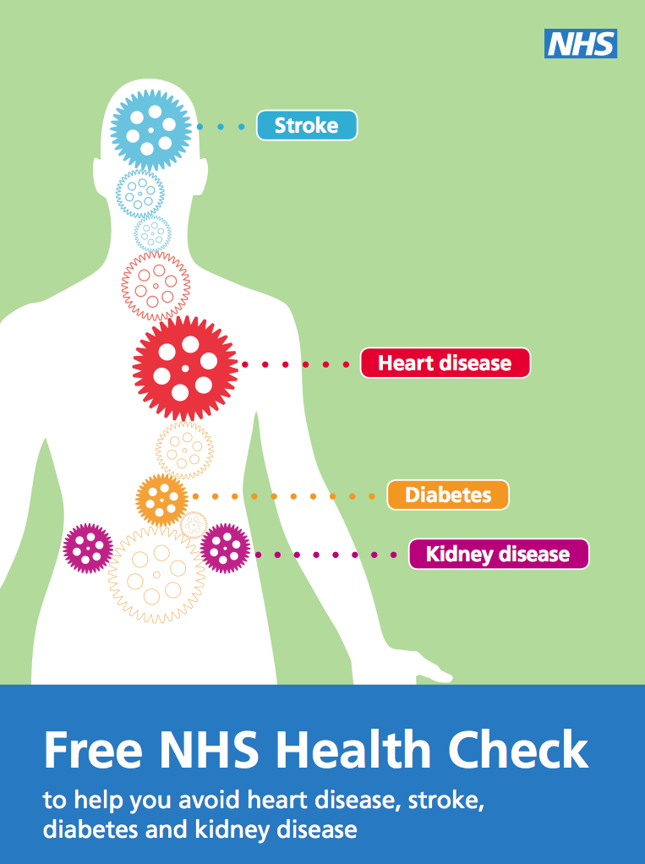
NHS Health Check programme
Legislative, national risk assessment, awareness & management programme
Systematically targets the top seven causes of preventable deaths: high blood pressure, smoking, high cholesterol, obesity, poor diet, physical inactivity & alcohol consumption (DH,2014)
https://www.nhs.uk/conditions/nhs-health-check/

Slide 37
Summary
Public Health Nutrition is a distinct, advanced area of practice addressing nutrition‑related health at population level
It requires integration of nutrition science, epidemiology, policy, and social determinants of health
Effective PHN practice moves upstream, focusing on prevention, equity and systems change
Interventions must be critically evaluated in terms of impact, unintended consequences and who benefits
Nutrition and dietetics professionals have a role beyond clinical care: influencing policy, environments and population health

Slide 38
References & Further Reading
Acheson D (1988) Public Health in England: The Report of the Committee of Inquiry into the Future Development to the Public Health Function, HMSO.
DH(2010) Equity and Excellence: Liberating the NHS, TSO
DH(2010): Healthy lives, healthy people: Our strategy for public health in England. http://www.dh.gov.uk/en/Publicationsandstatistics/Publications/PublicationsPolicyAndGuidance/DH_121941
DH (2011) Healthy lives, healthy people. Update and way forward. http://www.dh.gov.uk/en/Publicationsandstatistics/Publications/PublicationsPolicyAndGuidance/DH_128120
DH (2011) The new public health system: summary. http://www.dh.gov.uk/prod_consum_dh/groups/dh_digitalassets/documents/digitalasset/dh_131897.pdf
DH (2012) Health lives, healthy people: Improving outcomes and supporting transparency. http://www.dh.gov.uk/en/Publicationsandstatistics/Publications/PublicationsPolicyAndGuidance/DH_132358
Marmot, M (2010) Fair Society, Healthy Lives: strategic review of health inequalities in England post 2010. www.marmotreview.org
Polden M et al (2024) Evaluating the association between the introduction of mandatory calorie labelling and energy consumed using observational data from the out-of-home food sector in England. Nat Hum Behav (2024). https://doi.org/10.1038/s41562-024-02032-1
Robinson E et al (2019) Point of choice kilocalorie labelling in the UK eating out of home sector: a descriptive study of major chains. BMC Public Health 19, 1–6.

